Slide 1
Recognition by specialty
Crerated by
Armen Khlopuzyan, Amalia Sarkisyan

Slide 2

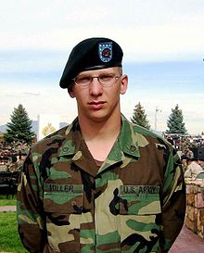
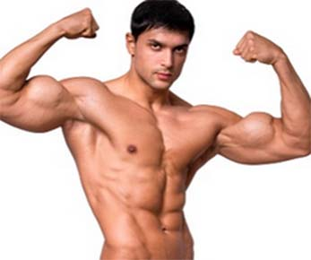
Identifying the profession of a person in the picture by clothing.
Profession forecast is based on the peculiarities of uniform (in particular, color gamma and active and passive zones of clothes).

Slide 3
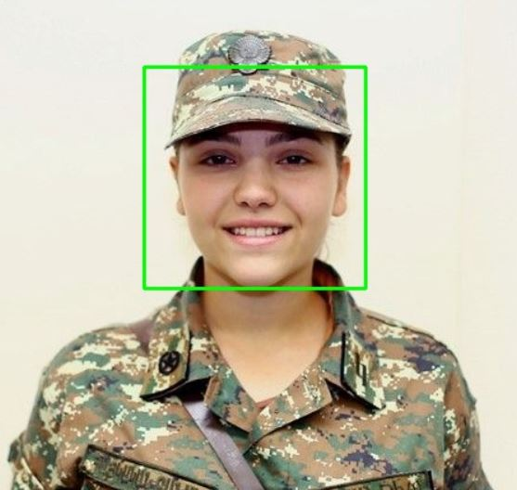
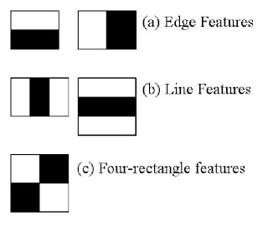
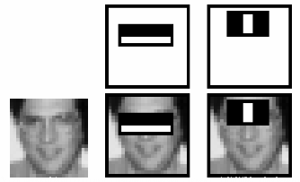
Changing the input image to grayscale
Histogram equalization
Face detection using Haar Cascade
- Loading the Haar Cascade File (XML file)
- Detecting the objects( face) by using detectMultiScale()
- Creation ROI over the detected Objects(face). i.e. Draw a rectangle over the detected object to mark it.

Slide 4
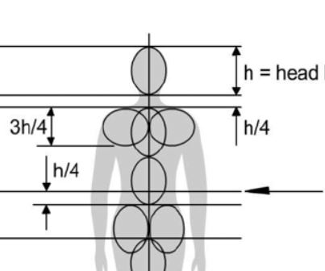
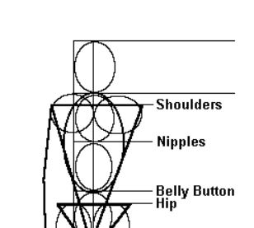
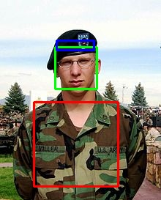
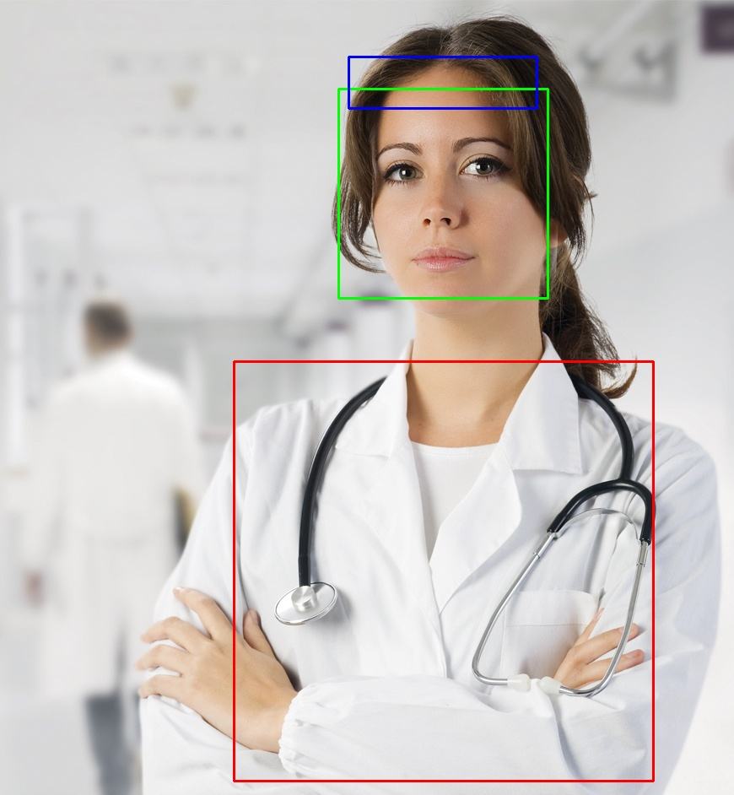
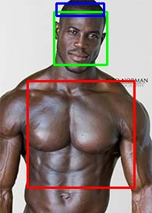
Upper body and hat detection using human body part proportion
(also by observing photos’ features)

Slide 5
Separation of active zones in the studied sections․
active
passive-1
passive-2
Making specific histogram for each specialty taking into account the color characteristics of uniform.
Definition of Indicators:
Based on indicators, prediction of the profession and measurement
of accuracy of forecasting.

Slide 6
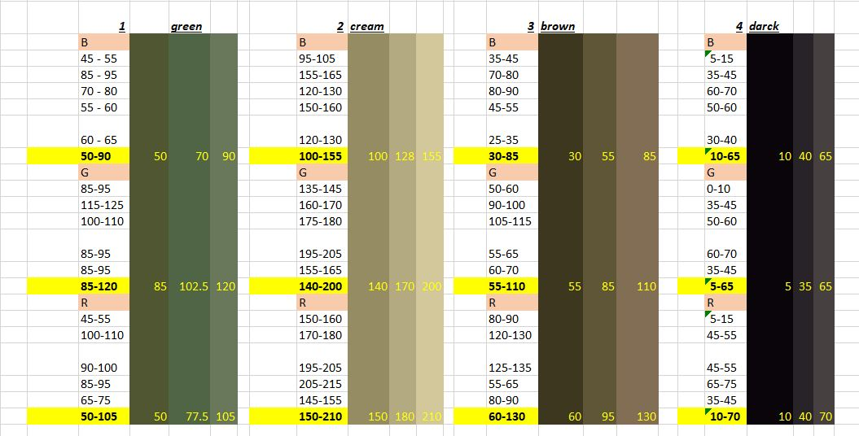
Soldier։
Identification of 4 main tones of military clothing. (green, cream, brown, black)

Slide 7
Histogram is made by according primary colors.
Soldier feature indicators
- feature_prcp (int) all primary colors percentage.
- feature_70 (bool) feature_70 is true if none of the primary colors is
distributed over 70% or more
- feature_aver-dis (int) feature_aver-dis is the number of primary colors that have a greater or equal average distribution
- feature_hat-35 (bool) feature_hat-35 is true if hypothetical hat is exist and
has 35% or more primary colors proportion
Prediction and measurement based on indicators.

Slide 8
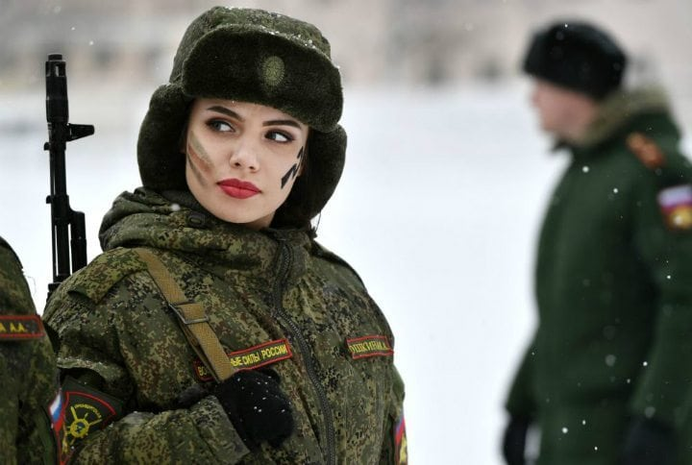
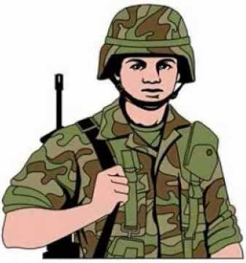


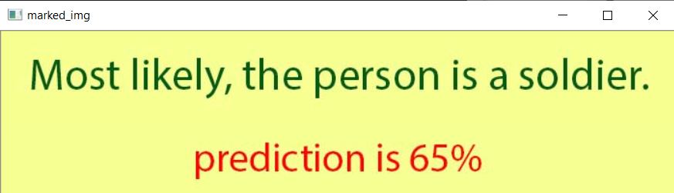

Slide 9
No-clothes։
Different histograms are made in accordance with colors
range(step 20 points) for the head and body.
Comparison of the largest three range values of body and
face histograms for all channels.
Prediction and measurement based on comparison results.

Slide 10
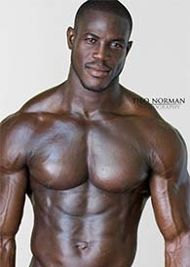
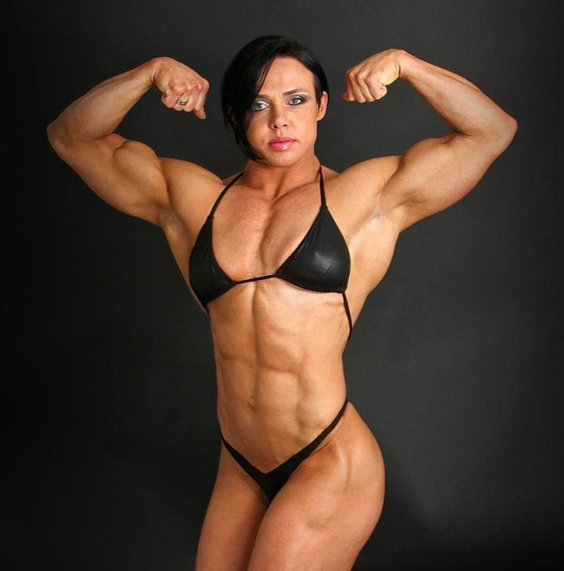
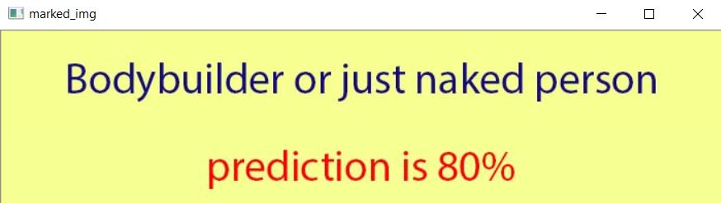

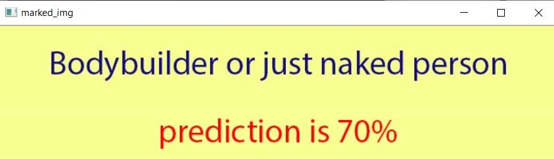

Slide 11
Doctor։
Separation of active zones in the studied sections․
active
passive
Identification of 2 main white tones of doctor clothing. (white, dirty white = shaded)
Histogram making.
Doctor feature indicators
- feature_55 (bool), - feature_75 (bool) , - feature_90 (bool)
feature_X is true if the primary colors is distributed over X% or more
and main color is more than (X-10)%
Prediction and measurement based on indicators.

Slide 12
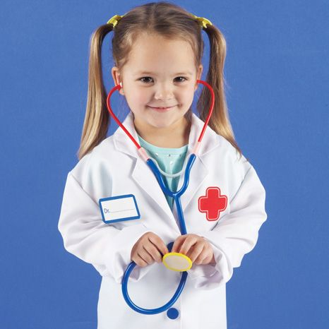

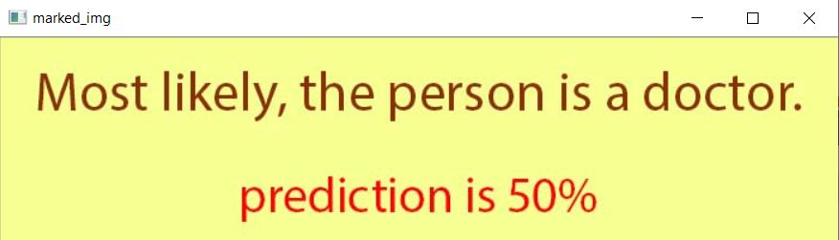
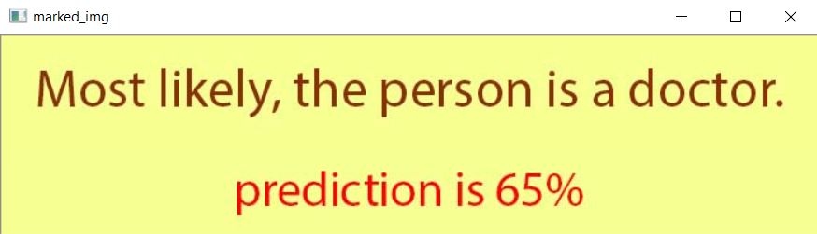

Slide 13
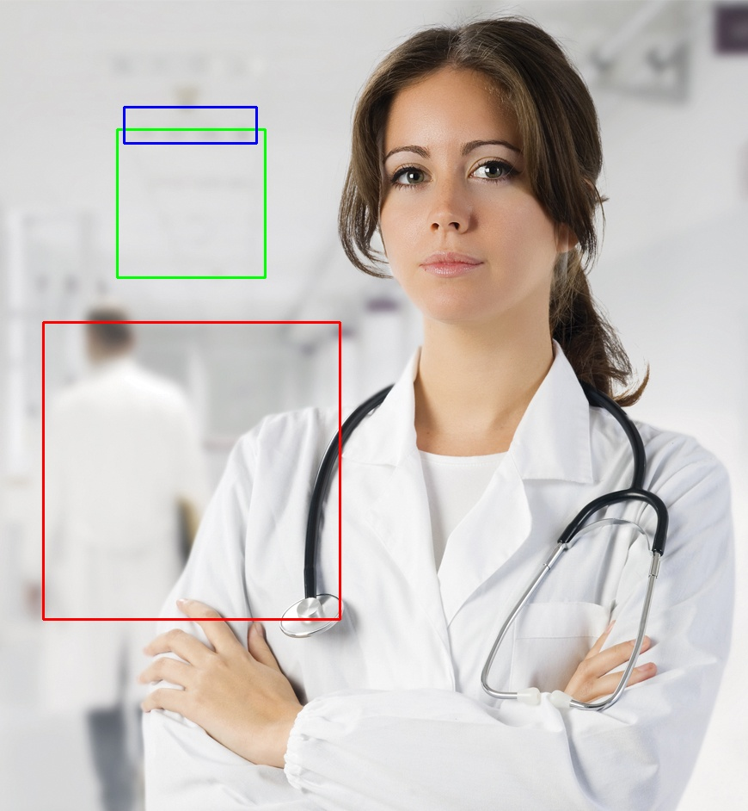
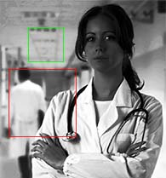

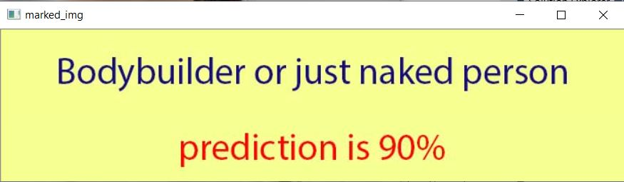
FAILURES։
equalized histogram

Slide 14
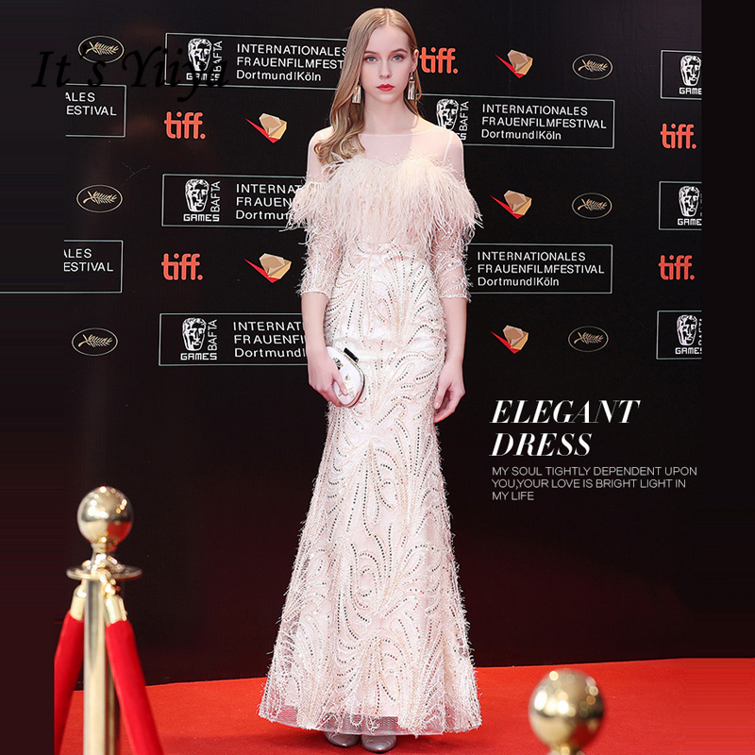
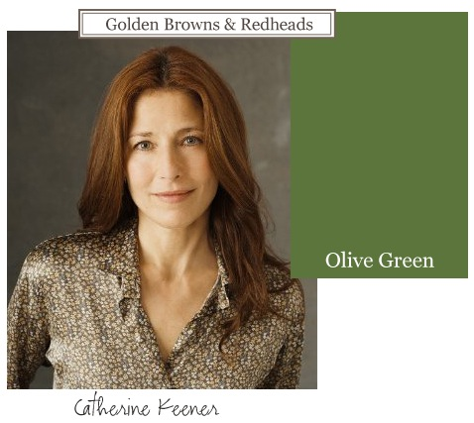
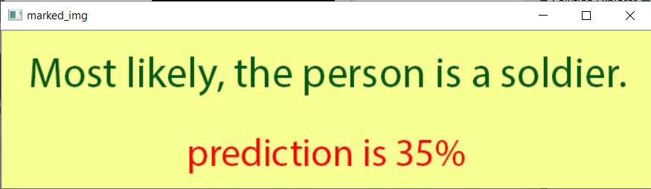
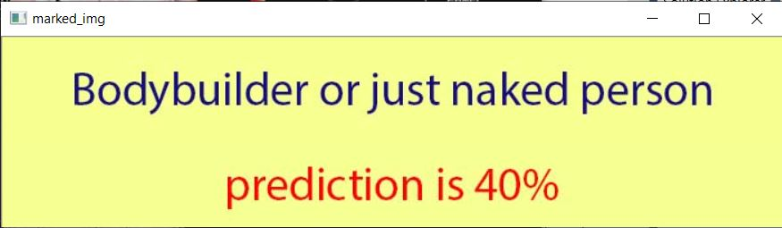
FAILURES։

Slide 15
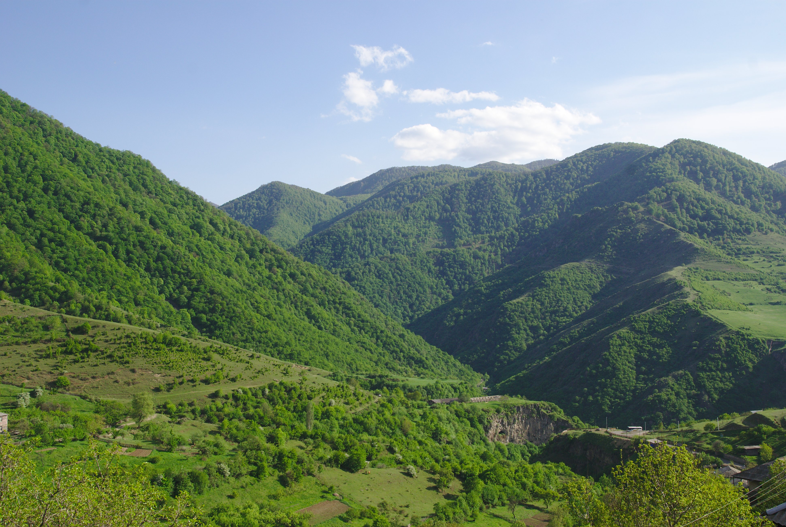
FAILURES։

Slide 16
FAILURES։

Slide 17
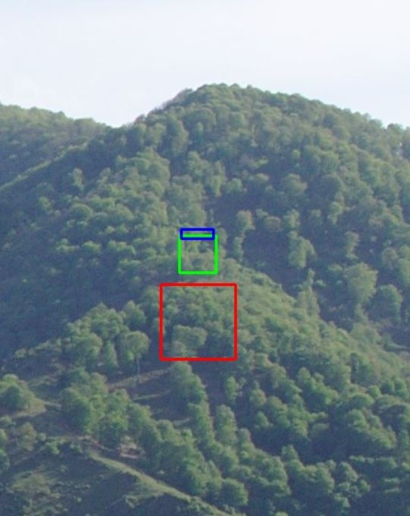

Slide 18
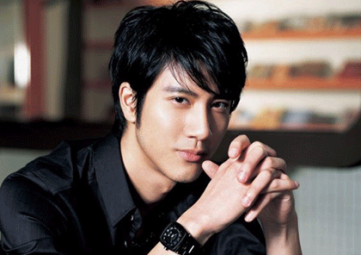
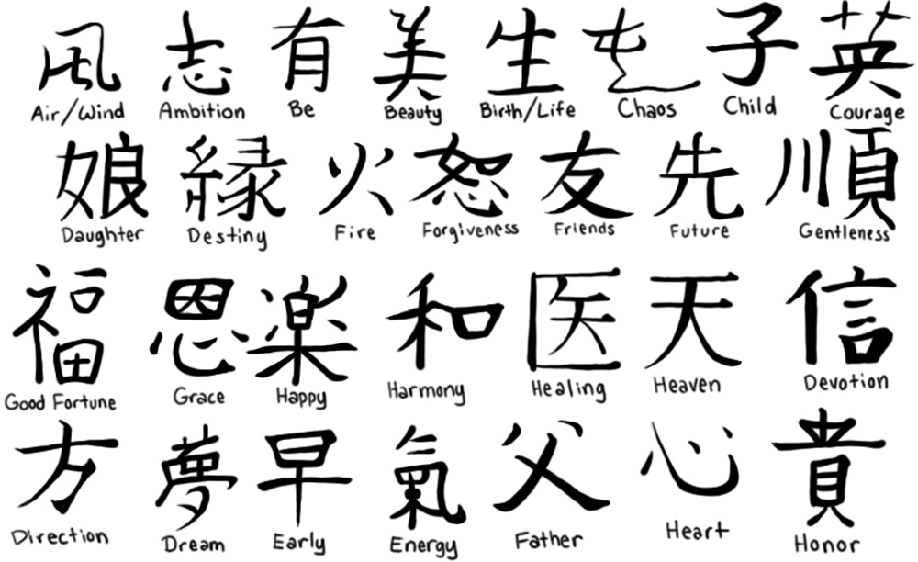
Speciality
Nationality
Tattoo
Brand and Price of clothes and accessories

Slide 19
THANK YOU FOR ATTENTION

